Slide 1
Stream Cipher, Block cipher, Modes of Operation
Dr. N.Gopika rani
CSE Department

Slide 2
S.NO | Block Cipher | Stream Cipher
1. | Block Cipher Converts the plain text into cipher text by taking plain text’s block at a time. | Stream Cipher Converts the plain text into cipher text by taking 1 byte of plain text at a time.
2. | Block cipher uses either 64 bits or more than 64 bits. | While stream cipher uses 8 bits.
3. | The complexity of block cipher is simple. | While stream cipher is more complex.
4. | Block cipher Uses confusion as well as diffusion. | While stream cipher uses only confusion.
5. | In block cipher, reverse encrypted text is hard. | While in-stream cipher, reverse encrypted text is easy.
6. | The algorithm modes which are used in block cipher are ECB (Electronic Code Book) and CBC (Cipher Block Chaining). | The algorithm modes which are used in stream cipher are CFB (Cipher Feedback) and OFB (Output Feedback).
7. | Block cipher works on transposition techniques like rail-fence technique, columnar transposition technique, etc. | While stream cipher works on substitution techniques like Caesar cipher, polygram substitution cipher, etc.
8. | Block cipher is slow as compared to a stream cipher. | While stream cipher is fast in comparison to block cipher.

Slide 3
Difference Between Confusion and Diffusion
Confusion | Diffusion
Confusion obscures the relationship between the plaintext and ciphertext. | Diffusion spreads the plaintext statistics through the ciphertext.
A one-time pad relies entirely on confusion while a simple substitution cipher is another (weak) example of a confusion-only cryptosystem. | A double transposition is the classic example of a diffusion-only cryptosystem.
Confusion hides the relation between the ciphertext and key. | Diffusion hides the relation between the ciphertext and the plaintext.
If a single bit in the key is changed, most or all bits in the ciphertext will also be changed. | If a single symbol in the plaintext is changed, several or all symbol in the ciphertext will also be changed
In confusion, the relationship between the statistics of the ciphertext and the value of the encryption key is made complex. It is achieved by substitution. | In diffusion, the statistical structure of the plain text is dissipated into long-range statistics of the ciphertext This is achieved by permutation.

Slide 4
Topics
Overview of Modes of Operation
EBC, CBC, CFB, OFB, CTR
Notes and Remarks on each modes

Slide 5
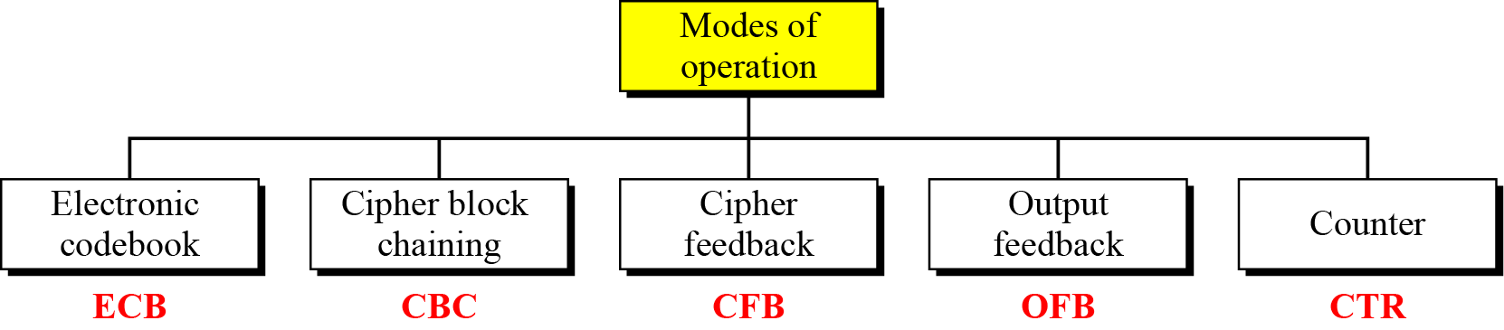
Modes of Operation Taxonomy
Current well-known modes of operation

Slide 6
Mode Technical Notes
Initialize Vector (IV)
  a block of bits to randomize the encryption and hence to produce distinct ciphertext
Nonce : Number (used) Once
  Random of psuedorandom number to ensure that past communications can not be reused in replay attacks
  Some also refer to initialize vector as nonce
Padding
  final block may require a padding to fit a block size
  Method
    Add null Bytes
    Add 0x80 and many 0x00
    Add the n bytes with value n

Slide 7
Electronic Codebook Book (ECB)
Message is broken into independent blocks which are encrypted
Each block is a value which is substituted, like a codebook, hence name
Each block is encoded independently of the other blocks
  C_{i} = E_{K} (P_{i})
Uses: secure transmission of single values

Slide 8
Topics
Overview of Modes of Operation
EBC, CBC, CFB, OFB, CTR
Notes and Remarks on each modes

Slide 9
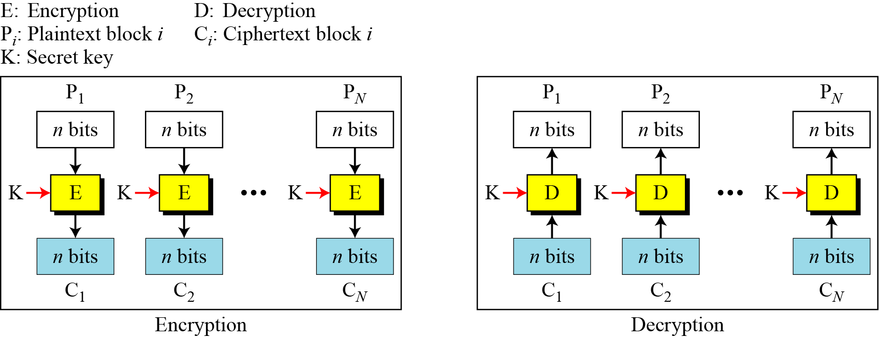
ECB Scheme
Notes:
Stallings Fig 3-11.

Slide 10
Remarks on ECB
Strength: it’s simple.
Weakness:
  Repetitive information contained in the plaintext may show in the ciphertext, if aligned with blocks.
  If the same message is encrypted (with the same key) and sent twice, their ciphertext are the same.
Typical application:
  secure transmission of short pieces of information (e.g. a temporary encryption key)

Slide 11
Cipher Block Chaining (CBC)
Solve security deficiencies in ECB
  Repeated same plaintext block result different ciphertext block
Each previous cipher blocks is chained to be input with current plaintext block, hence name
Use Initial Vector (IV) to start process
  C_{i} = E_{K} (P_{i} XOR C_{i-1})
  C₀ = IV
Uses: bulk data encryption, authentication
Notes:
To overcome the problems of repetitions and order independence in ECB, want some way of making the ciphertext dependent on all blocks before it. This is what CBC gives us, by combining the previous ciphertext block with the current message block before encrypting. To start the process, use an Initial Value (IV), which is usually well known (often all 0's), or otherwise is sent, ECB encrypted, just before starting CBC use. CBC mode is applicable whenever large amounts of data need to be sent securely, provided that its available in advance (eg email, FTP, web etc)

Slide 12
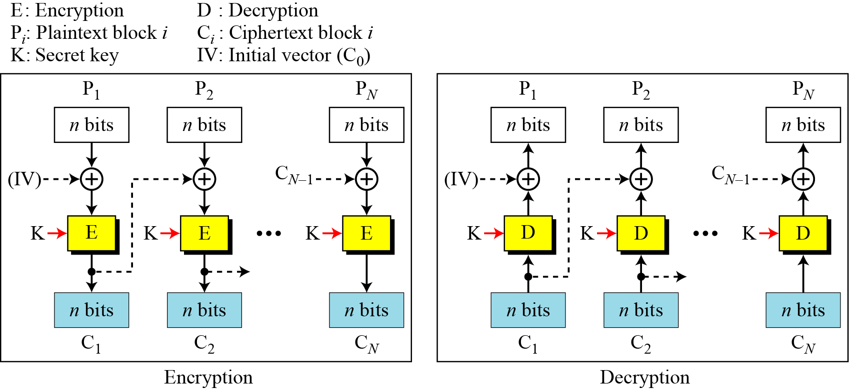
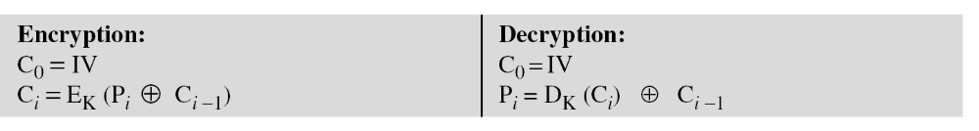
CBC scheme
Notes:
Stallings Fig 3-12.

Slide 13
Remarks on CBC
The encryption of a block depends on the current and all blocks before it.
So, repeated plaintext blocks are encrypted differently.
Initialization Vector (IV)
  May sent encrypted in ECB mode before the rest of ciphertext

Slide 14
Cipher FeedBack (CFB)
Use Initial Vector to start process
Encrypt previous ciphertext , then combined with the plaintext block using X-OR to produce the current ciphertext
Cipher is fed back (hence name) to concatenate with the rest of IV
Plaintext is treated as a stream of bits
  Any number of bit (1, 8 or 64 or whatever) to be feed back (denoted CFB-1, CFB-8, CFB-64)
Relation between plaintext and ciphertext
  C_{i} = P_{i} XOR SelectLeft(E_{K} (ShiftLeft(C_{i-1})))
  C₀ = IV
Uses: stream data encryption, authentication
Notes:
If the data is only available a bit/byte at a time (eg. terminal session, sensor value etc), then must use some other approach to encrypting it, so as not to delay the info. Idea here is to use the block cipher essentially as a pseudo-random number generator (see stream cipher lecture later) and to combine these "random" bits with the message. Note as mentioned before, XOR is an easily inverted operator (just XOR with same thing again to undo). Again start with an IV to get things going, then use the ciphertext as the next input. As originally defined, idea was to "consume" as much of the "random" output as needed for each message unit (bit/byte) before "bumping" bits out of the buffer and re-encrypting. This is wasteful though, and slows the encryption down as more encryptions are needed. An alternate way to think of it is to generate a block of "random" bits, consume them as message bits/bytes arrive, and when they're used up, only then feed a full block of ciphertext back. This is CFB-64 mode, the most efficient. This is the usual choice for quantities of stream oriented data, and for authentication use.

Slide 15
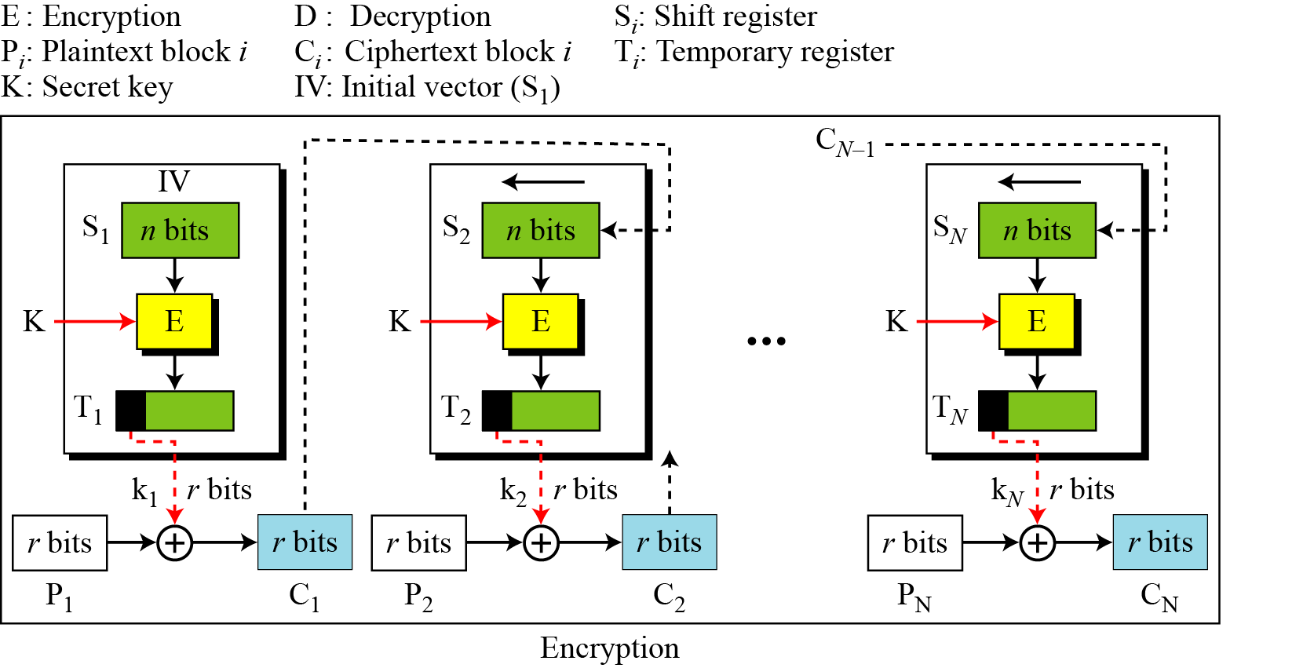
CFB Scheme

Slide 16
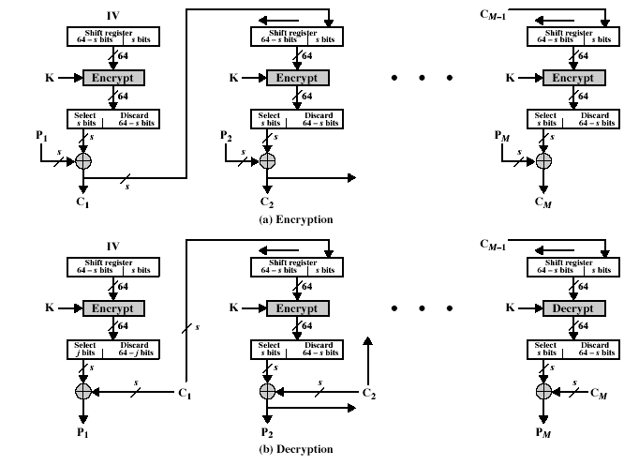
CFB Encryption/Decryption
Notes:
Stallings Fig 3-13.

Slide 17
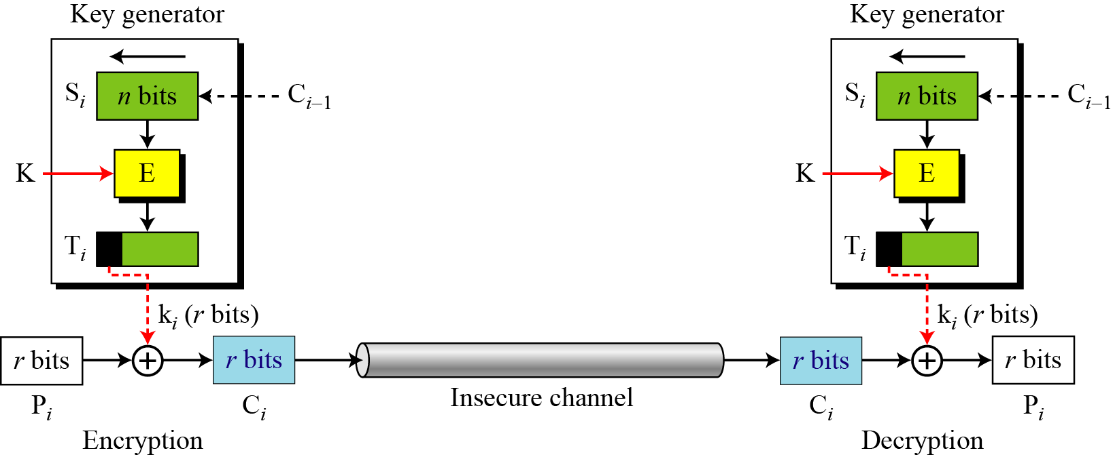
CFB as a Stream Cipher
In CFB mode, encipherment and decipherment use the encryption function of the underlying block cipher.

Slide 18
Output FeedBack (OFB)
Very similar to CFB
But output of the encryption function output of cipher is fed back (hence name), instead of ciphertext
Feedback is independent of message
Relation between plaintext and ciphertext
  C_{i} = P_{i} XOR O_{i}
  O_{i} = E_{K} (O_{i-1})
  O₀ = IV
Uses: stream encryption over noisy channels
Notes:
The alternative to CFB is OFB. Here the generation of the "random" bits is independent of the message being encrypted. The advantage is that firstly, they can be computed in advance, good for bursty traffic, and secondly, any bit error only affects a single bit. Thus this is good for noisy links (eg satellite TV transmissions etc).

Slide 19
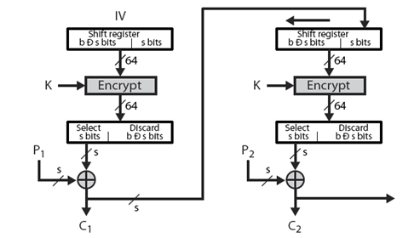
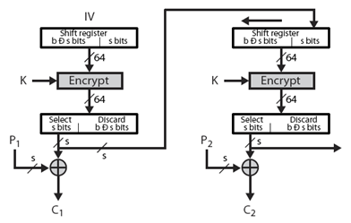
CFB V.S. OFB
Cipher Feedback
Output Feedback

Slide 20
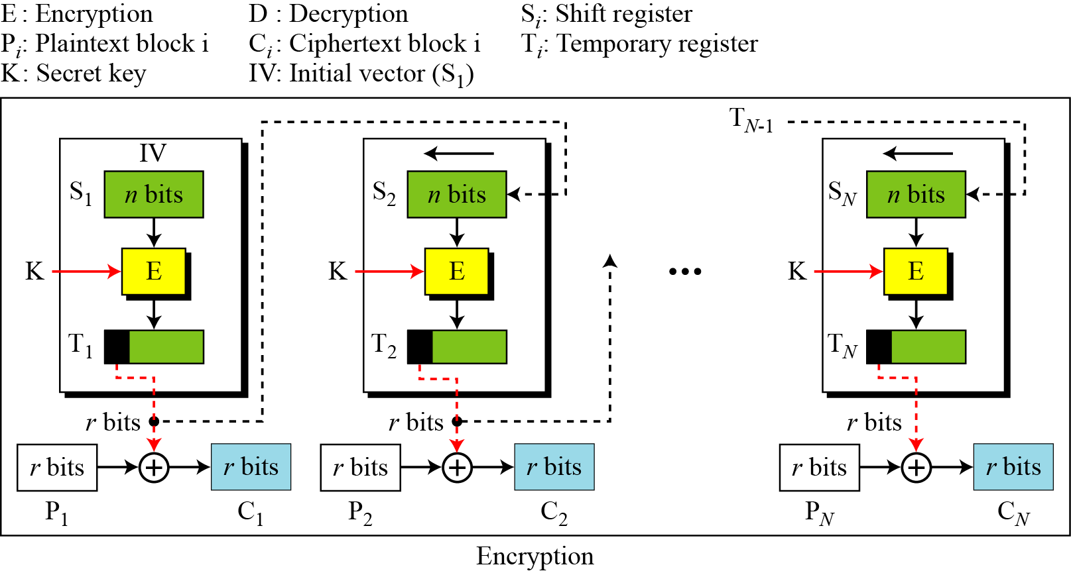
OFB Scheme

Slide 21
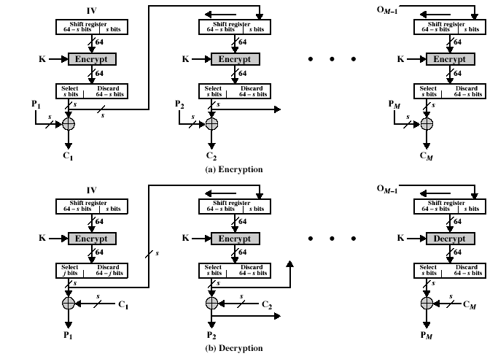

OFB Encryption and Decryption
Notes:
Stallings Fig 3-14.

Slide 22
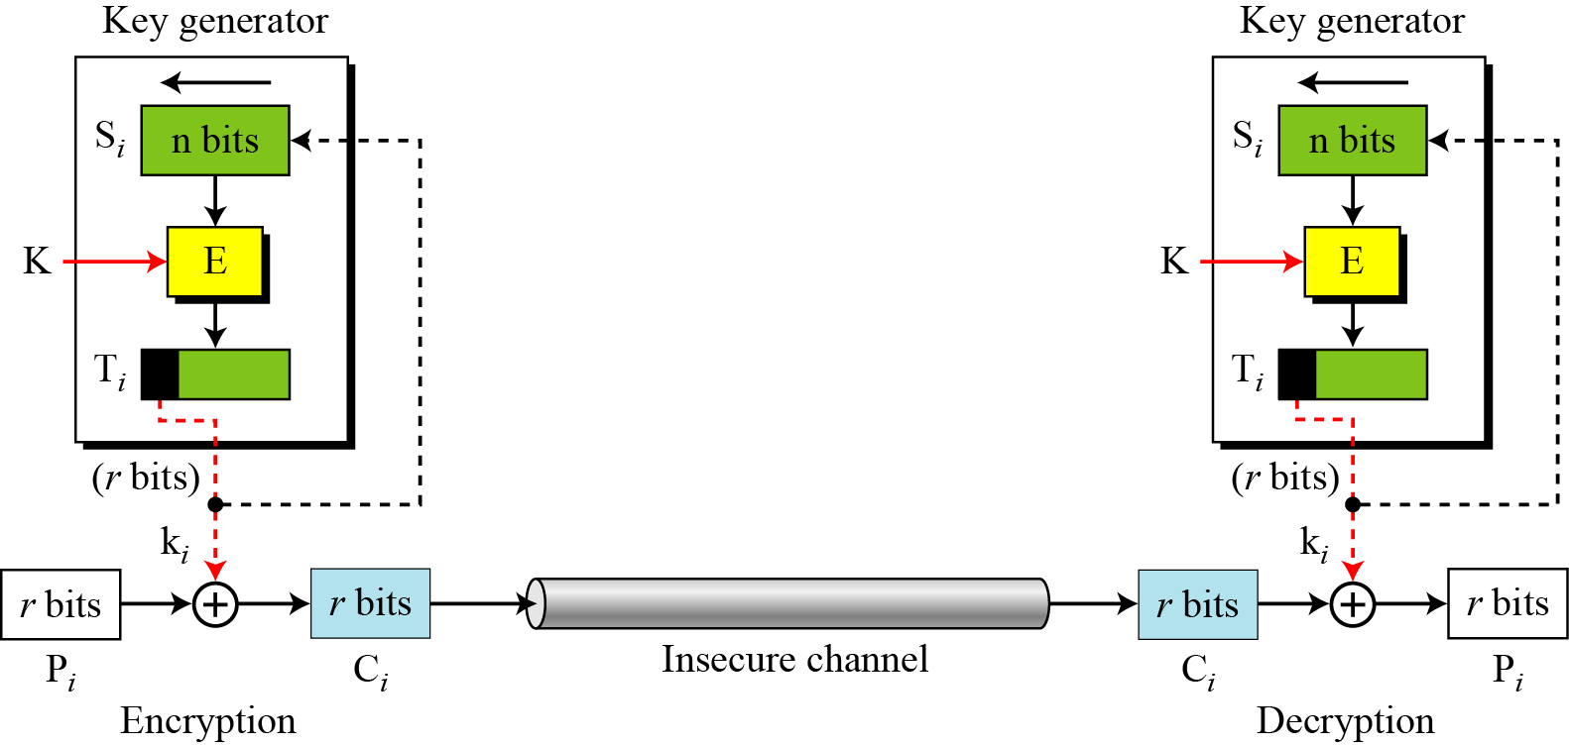
OFB as a Stream Cipher
In OFB mode, encipherment and decipherment use the encryption function of the underlying block cipher.

Slide 23
Remarks on OFB
Each bit in the ciphertext is independent of the previous bit or bits. This avoids error propagation
Pre-compute of forward cipher is possible
Security issue
  when j^{th} plaintext is known, the j^{th} output of the forward cipher function will be known
  Easily cover j^{th} plaintext block of other message with the same IV
Require that the IV is a nonce
Notes:
Because the "random" bits are independent of the message, they must never ever be used more than once (otherwise the 2 ciphertexts can be combined, cancelling these bits, and leaving a "book" cipher to solve). Also, as noted, should only ever use a full block feedback ie OFB-64 mode.

Slide 24
Counter (CTR)
Encrypts counter value with the key rather than any feedback value (no feedback)
Counter for each plaintext will be different
  can be any function which produces a sequence which is guaranteed not to repeat for a long time
Relation
  C_{i} = P_{i} XOR O_{i}
  O_{i} = E_{K} (i)
Uses: high-speed network encryptions

Slide 25
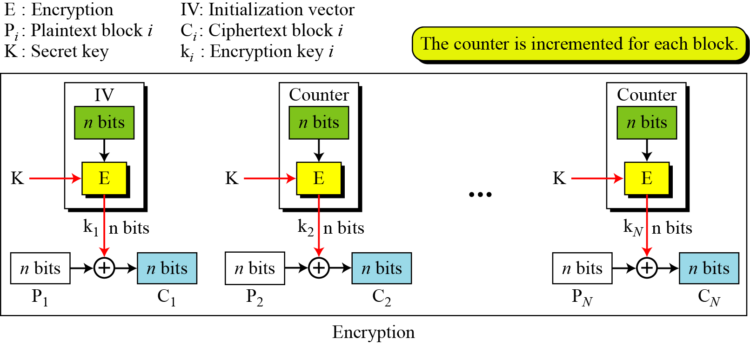
CTR Scheme

Slide 26
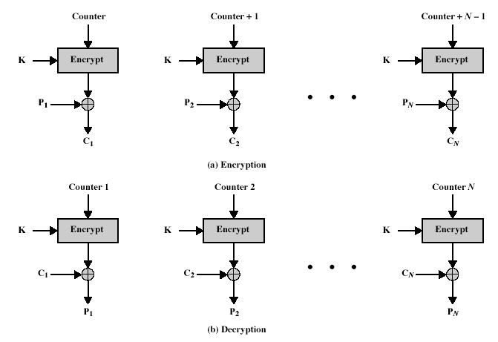
CTR Encryption and Decryption
Notes:
Stallings Fig 3-15.

Slide 27
Remark on CTR
Strengths:
  Needs only the encryption algorithm
  Random access to encrypted data blocks
    blocks can be processed (encrypted or decrypted) in parallel
  Simple; fast encryption/decryption
Counter must be
  Must be unknown and unpredictable
  pseudo-randomness in the key stream is a goal

Slide 28
Remark on each mode
Basically two types:
  block cipher
  stream cipher
CBC is an excellent block cipher
CFB, OFB, and CTR are stream ciphers
CTR is faster because simpler and it allows parallel processing

Slide 29
CBC and CTR comparison
CBC | CTR
Padding needed | No padding
No parallel processing | Parallel processing
Separate encryption and decryption functions | Encryption function alone is enough
Random IV or a nonce | Unique nonce
Nonce reuse leaks some information about initial plaintext block | Nonce reuse will leak information about the entire message

Slide 30
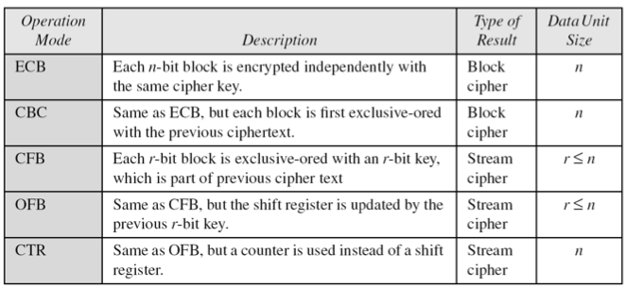
Comparison of Different Modes

Slide 31
Comparison of Modes
Mode | Description | Application
ECB | 64-bit plaintext block encoded separately | Secure transmission of encryption key
CBC | 64-bit plaintext blocks are XORed with preceding 64-bit ciphertext | Commonly used method. Used for authentication
CFB | s bits are processed at a time and used similar to CBC | Primary stream cipher. Used for authentication

Slide 32
Comparison of Modes
Mode | Description | Application
OFB | Similar to CFB except that the output is fed back | Stream cipher well suited for transmission over noisy channels
CTR | Key calculated using the nonce and the counter value. Counter is incremented for each block | General purpose block oriented transmission. Used for high-speed communications

